Slide 1
TWEET CLASSIFICATION
CSCE 689: Natural Language Processing
Instructor: Dr.Ruihong Huang
Presented by: Saurabh Nayak

Slide 2
Task and Problem
Why Twitter?
Classify a given tweet into one of the categories
Determine the best classifier among NB, SVM and Decision Tree
500 million tweets per day
Medium for real-time information dissemination.
Notes:
Twitter has been used as a medium to disseminate real-time information and has been used in various brand campaigns, elections, and as a news media. Every second, on an average around 6,000 tweets are tweeted on Twitter, which corresponds to over 350,000 tweets sent per minute, 500 million tweets per day. With so many tweets at disposal, one can exploit the tweets to extract important information like occurring of events. The events can be: elections, sports, natural calamities, outbreak of virus,etc.

Slide 3
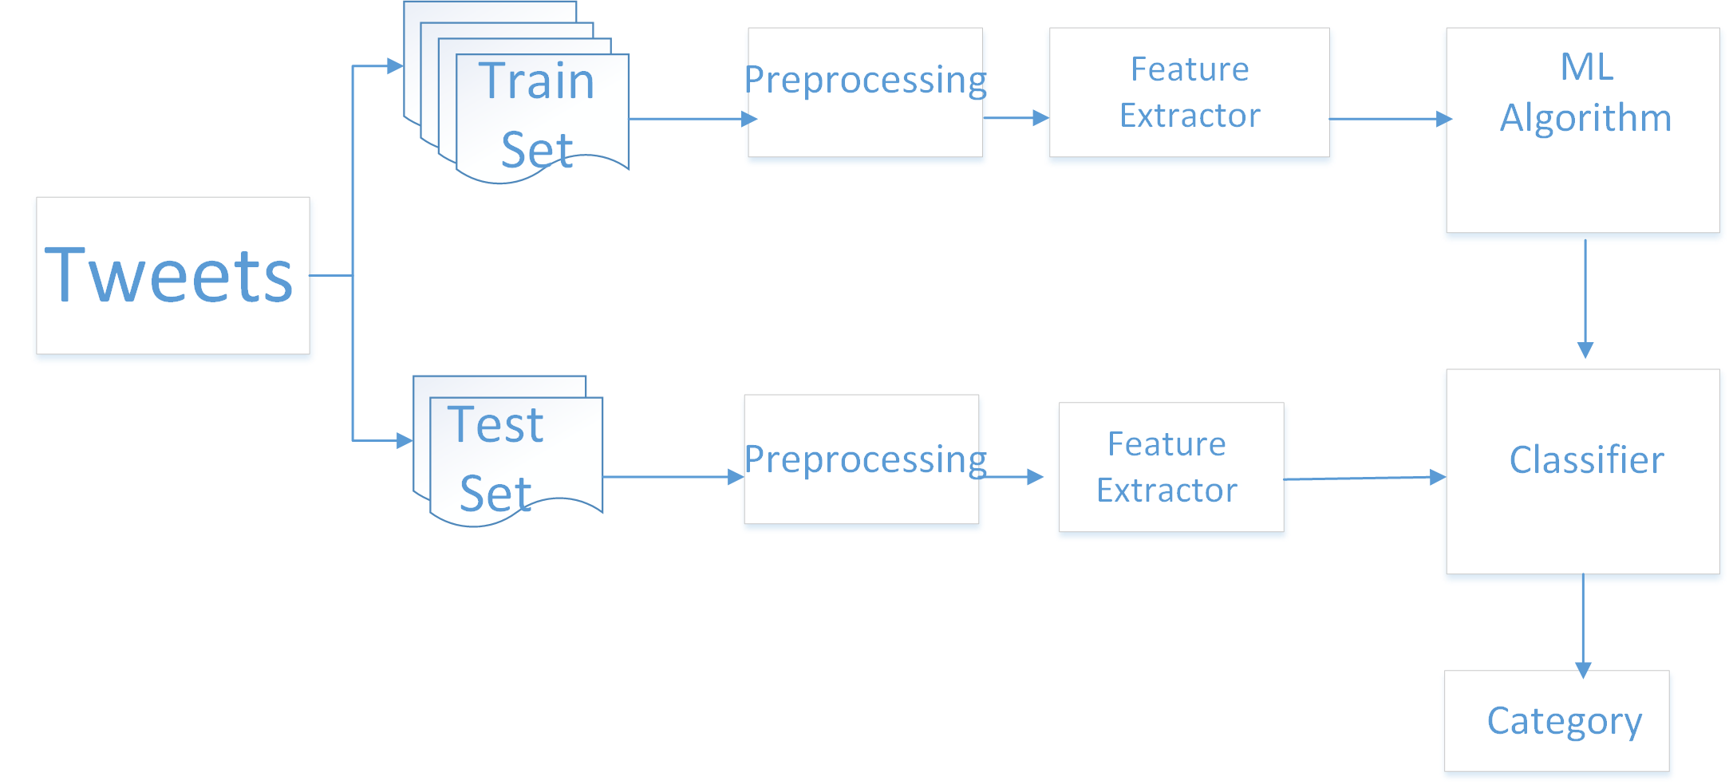
High-level description of approach
Search Engine
Tweet filtering
Preprocessing
Training and classification
Result metrics
Notes:
First we are extracting the tweets
Then tweet filetering and preporcessing to make a clean dataset
Then training and classification using supervised algorithm: NB, SVM and Decision tree

Slide 4
Categories
Education
Entertainment
Law
Nature
Sport
Technology
Politics
Fashion
Health
Travel

Slide 5
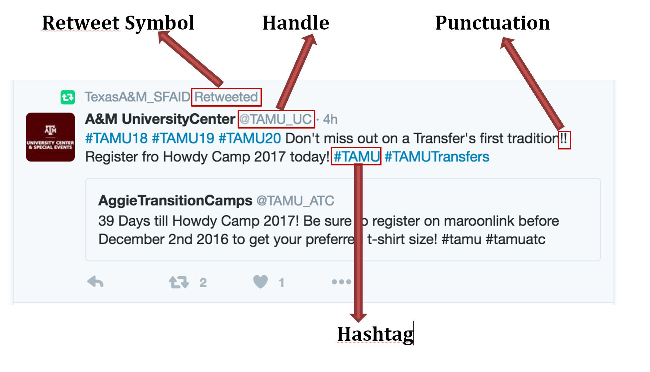
Specific system implementation
Data Collection
Tweepy library
TwitterSearch library
450 requests per 15 min window.
100 tweets per request
Notes:
We see that a tweet has these important features: retweet symbol, handle, punctuation and hashtag.
We are using the hashtag to get tweets for a relevant category.
For eg: #travel or #wanderlust is used to get travel related tweets.
Twitter allows 450 requests in 15 min window. So we can ping twitter api in every 15 minutes.

Slide 6
2. Tweet Filtering
Removing spam
Handles like SuperDeals or SBargainsUK Eg: @SuperDeals #C02 1pcs #HOT Beauty #Nail #Art http://tinyurl.com/jzdputy #Health #Travel #Beauty #SuperDeals #AliExpress #SuperDeal
Removing redundant retweets
RTs or tweets waith similar message Ex: @adam Not all those who wander are lost. #travel #wanderlust @wiliaml RT @adam Not all those who wander are lost. #travel #wanderlust
Notes:
Once we get the tweet data, we see one of the issue is that some handles are occurring in every category and they are bringing down the quality of dataset as they do not actually come under one category.

Slide 7
3. Preprocessing
Stemming
Lemmatization
Spelling correction
Removing punctuation
Stop words

Slide 8
4. Training and Classification
10- fold cross validation
Supervised Algorithms:
Naive Bayes
Support Vector Machines (SVM)
Decision Tree
Notes:
SInce we already have done preprocessing, we have features in form of TF-IDF and we use these features as an input to various ML algorithms

Slide 9
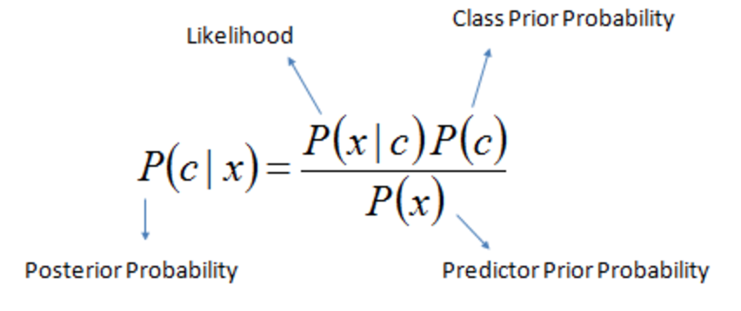
Algorithm 1: Naive Bayes
Bayes Rule:
Easy and fast.

Slide 10
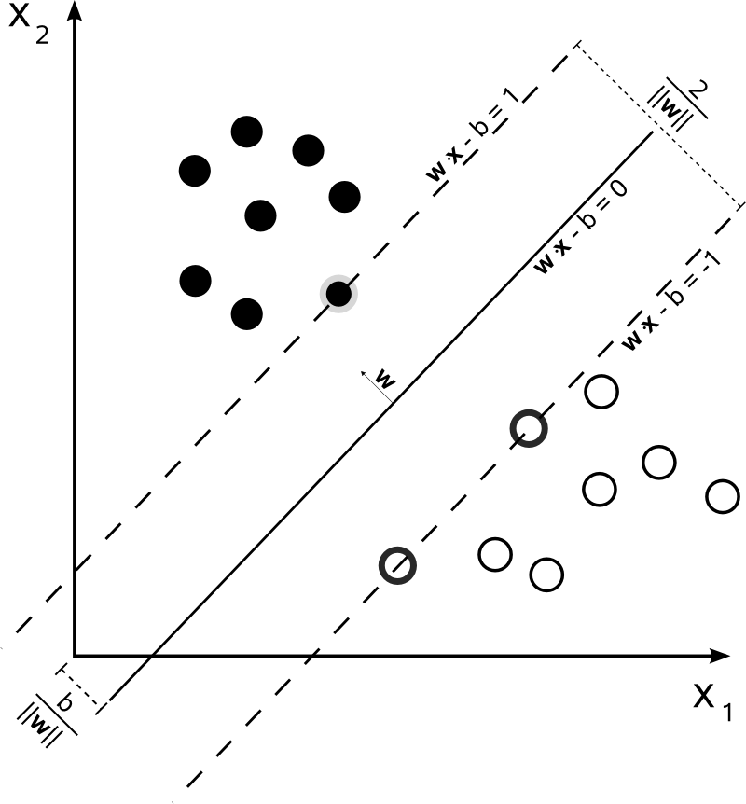
Algorithm 2: Support Vector Machine (SVM)
Intuition: Find a hyperplane that maximizes the margin between the points.
Only support vectors(examples closest to hyperplane) matter and can ignore other training examples

Slide 11
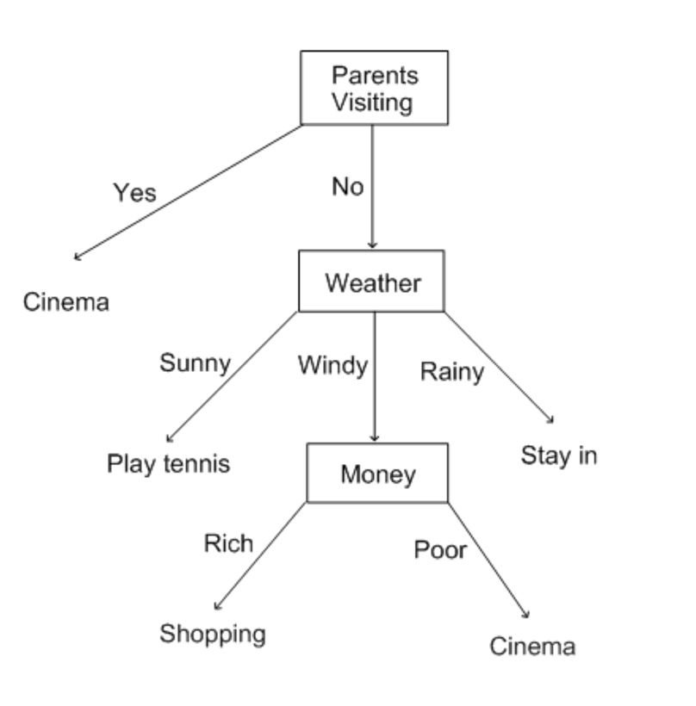
Algorithm 3: Decision Tree
Graphical representation of possible solutions to a decision based on certain conditions
Starts with a single box (or root), which then branches off into a number of solutions, just like a tree

Slide 12
Algorithm 3: Decision Tree
Advantages of decision tree
Are simple to understand and interpret. People are able to understand decision tree models after a brief explanation.
Have value even with little hard data.
Allow the addition of new possible scenarios
Help determine worst, best and expected values for different scenarios
Disadvantages of decision trees:
For data including categorical variables with different number of levels, information gain in decision trees are biased in favor of those attributes with more levels
Calculations can get very complex particularly if many values are uncertain and/or if many outcomes are linked.
Notes:
Have value even with little hard data. Important insights can be generated based on experts describing a situation (its alternatives, probabilities, and costs) and their preferences for outcomes.

Slide 13
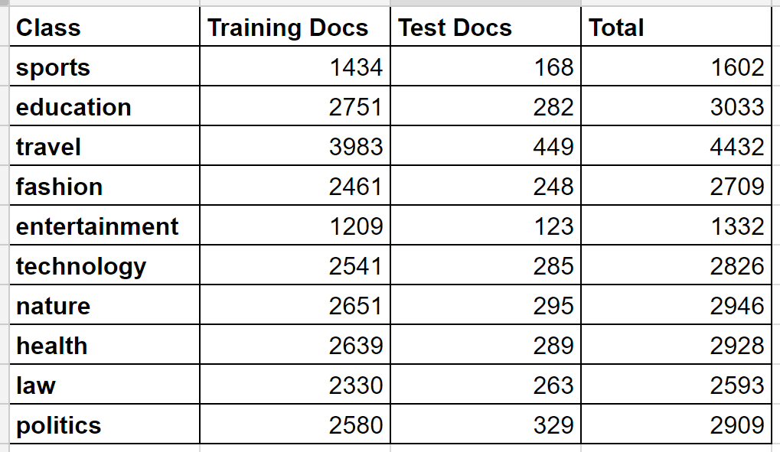
Evaluation
10 fold cross-validation
Baseline: One with the largest dataset i.e. Travel category chosen as predicted.

Slide 14
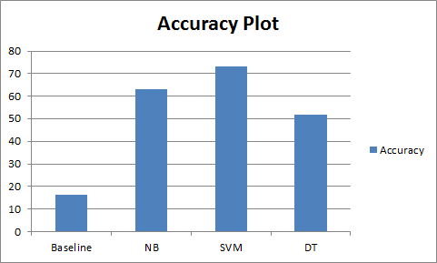
Result
SVM showed the best accuracy amongst the other classifiers

Slide 15
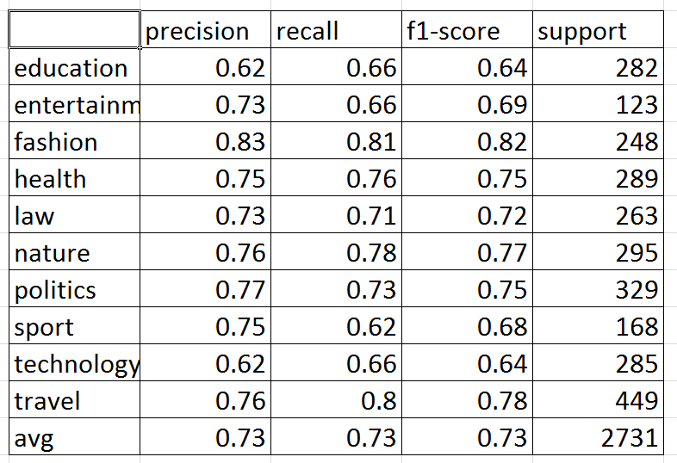
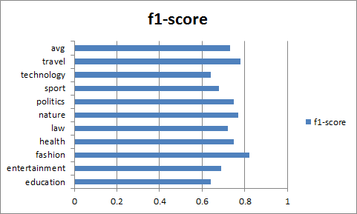
Result SVM metrics

Slide 16
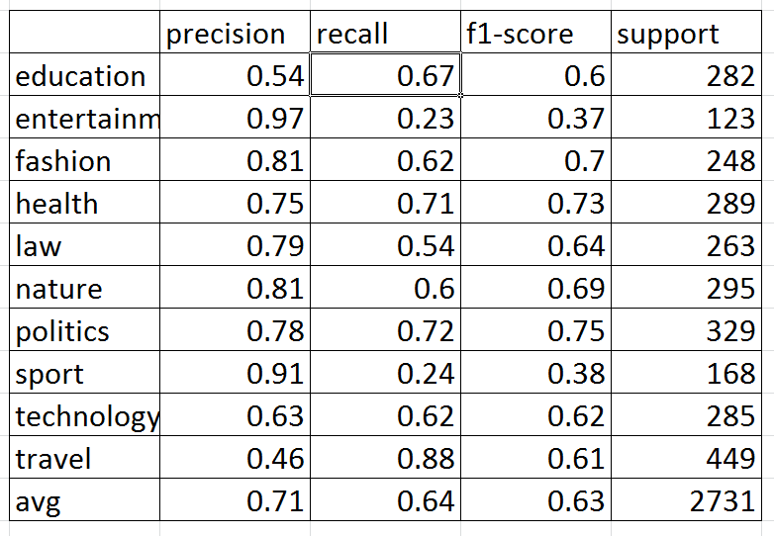
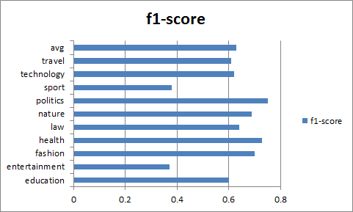
Result NB metrics

Slide 17
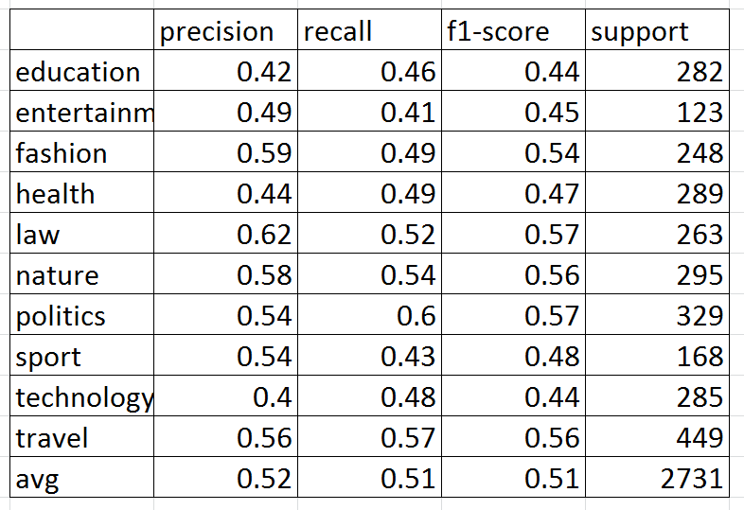
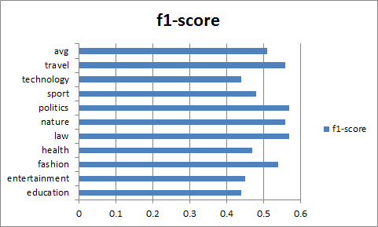
Result Decision Tree metrics

Slide 18
Analysis
Baseline accuracy : 16.44%
Naive Bayes accuracy: 63%
Decision tree accuracy: 52%
SVM accuracy: 73%
DT does not perform well : Because decision tree need several key nodes, while it's hard to find "several key tokens" for text classification.
SVM showed better performance in comparison with NB as it would have found better support vectors. Since most of the tweets contain less number of words, SVM has higher performance than NB
Notes:
Decision tree does not perform well : Because decision tree need several key nodes, while it's hard to find "several key tokens" for text classification, and random forest is not so good for high sparse dimensions.

Slide 19
